Slide 1
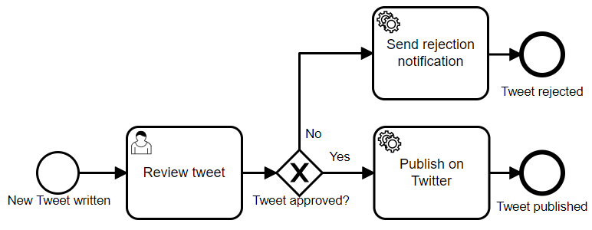
Scope 1: Unit Tests
Simple Unit tests
API
Glue code
Business logic mocks
Scope 2: Process Tests
Implemented as unit tests
In Memory
No external resources needed
Single Threaded whenever possible
Business logic
UI
External Systems
Scope 3: Integration Tests
Close-to-real-life environment

Slide 2
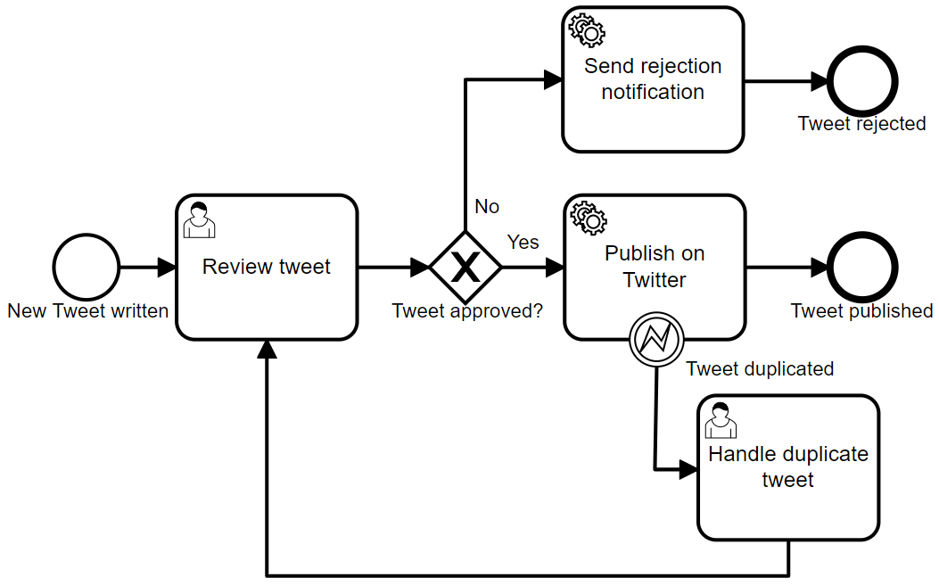
ReviewTweetRestApi
TwitterProcess
PublishTweetWorker
TweetPublicationService
TweetPublicationServiceMock
TweetPublicationServiceImpl
Twitter

